Slide 1

Art and culture on prescription in Italy
Key findings from the first Italian national survey on social prescribing and cultural welfare
Simona Staffieri
Project Manager Officer, CCW Cultural Welfare Center
Culture, Health and Social Prescribing Conference • Ljubljana 2026

Slide 2

THEORETICAL FRAMEWORK
Context and theoretical framework of the Italian research
1. WHO 2019 evidence base
Grounding in 3,000+ studies (Fancourt & Finn) confirming arts interventions prevent and manage health conditions across the lifespan.
Cultural participation as a non-pharmacological health asset.
2. Social determinants of health
Addressing isolation, distress, and health inequities (Dahlgren & Whitehead model).
Conceptualizing the 'cultural exposome': environmental and aesthetic factors shaping long-term well-being.
3. Salutogenic approach
Shifting focus from disease treatment to resource activation and resilience building.
Cultural welfare as an integrated community infrastructure bridging health and culture.

Slide 3
METHODOLOGY
Integrated research methodology: three levels
Level 1: Systematic review
Analysis of 3,000+ scientific sources and international social prescribing frameworks.
Standardization of definitions and operational indicators.
Level 2: Quantitative survey
National mapping of 918 validated organizations across Italy.
Comprehensive mapping of target populations, referral routes, and financial structures.
Level 3: Qualitative study
14 in-depth interviews with national experts and key stakeholders.
Qualitative focus groups analyzing human infrastructure, dignity, and link worker dynamics.

Slide 4
QUANTITATIVE EVIDENCE
Survey scope: mapping the Italian context
Survey response funnel
• 2,142 initial contacts identified
• 1,657 respondents reached (77.3% response rate)
• 1,257 active entities in cultural health
• 918 fully validated survey responses
European Synergy & Alignment
• Methodologically aligned with the
European CultureForHealth framework
• CultureForHealth mapped 675 entities across 27 European countries
• Italian survey provides a capillary
country-specific deep dive (918 entities)

Slide 5
HEADLINE METRICS
Core quantitative findings: five headline metrics
918
Validated entities in the national survey
97%
Completion rate of prescribed activities
75%
Interventions focused on mental well-being
8%
Current prescriptions from general practitioners
40%
Programs lacking structured follow-up

Slide 6
FIELD PROFILE
Two profiles: social prescription vs cultural welfare
Social Prescription Units
617 Entities (67.2%)
• Organizations already operating with formal prescription mechanisms.
• Directly linked with health and social care prescribers.
• Strong focus on clinical referrals and targeted vulnerable groups.
• High standardization of care pathways.
Cultural Welfare Units
301 Entities (32.8%)
• Cultural institutions delivering health-promoting activities.
• 97% express explicit intent to formalize prescription pathways.
• Highly mature artistic quality and community engagement.
• Represent the supply side ready for health integration.

Slide 7
ORGANIZATIONAL MATURITY
Profile: mature structures and hybrid identity
High organizational longevity
• 76.2% of entities have been active for over 10 years.
• Proves social prescribing in Italy is not an ephemeral trend, but a consolidated practice.
Robust staff capacity
• 58.4% operate with more than 10 workers.
• Significantly higher structured staffing compared to standard cultural non-profits (ISTAT average).
Hybrid socio-cultural mission
• 64.1% possess dual statutory goals (arts + health/social inclusion).
• Native intersectoral DNA bridging healthcare and culture.

Slide 8
GEOGRAPHICAL ANALYSIS
Geographical distribution
North-West
39.2%
116 Units
Highest density driven by regional policies in Piedmont & Liguria.
Center
27.1%
80 Units
Strong hub around Tuscany, Lazio, and Umbria community networks.
North-East
19.7%
58 Units
Active clusters in Emilia-Romagna, Veneto, and Friuli.
South & Islands
14.0%
41 Units
Emerging practices facing infrastructural fragmentation.
Based on the 295 entities reporting complete regional data.

Slide 9
CULTURAL INTERVENTIONS
Prescribed cultural activities: word, space, and heritage
Shared reading & aloud reading
42.1% of interventions
Museum & heritage visits
35.4% of interventions
Narrative walks & heritage trails
32.1% of interventions
Community & social theater
28.7% of interventions
Visual arts & creative workshops
26.8% of interventions
Music & choral singing
23.2% of interventions

Slide 10
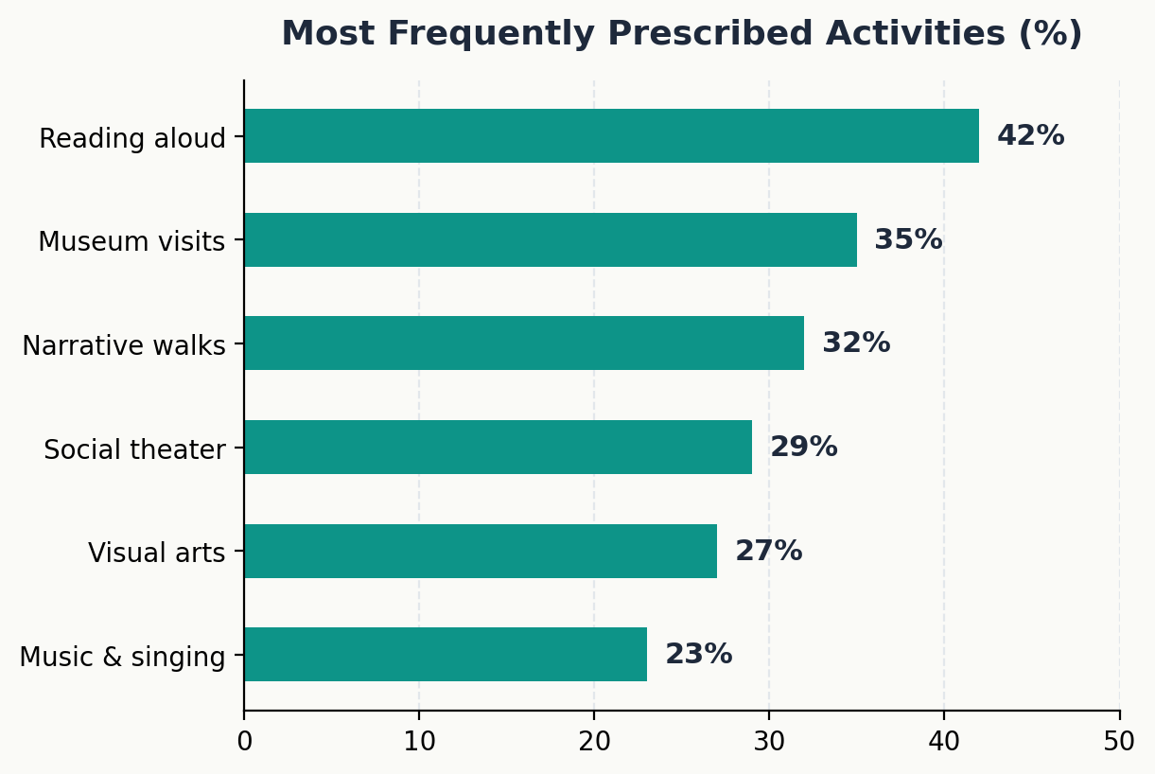
CULTURAL INTERVENTIONS

Slide 11
PRESCRIBERS
Referral network: who prescribes in Italy
Primary prescribing figures
• Psychologists & Psychotherapists: 32.4%
• Social Workers & Educators: 25.1%
• Specialist Physicians (Neurology, Psychiatry, Oncology): 24.3%
• General Practitioners (GPs / MMG): 8.2%
• Self-referral & Family networks: 10.0%
Key strategic insight
Unlike the UK model centered on General Practitioners, Italy's prescribing network is led by psychologists and social care professionals.
This reflects the integration of cultural prescribing within mental health departments and local social services rather than primary care clinics.

Slide 12
BENEFICIARIES
Target populations: reaching vulnerability without stigma
Age demographics
• Adults (18-64): 82.1%
• Older Adults (65+): 49.3%
• Children (0-11): 47.1%
• Youth & NEETs: 36.4%
Clinical & social profiles
• Mild-to-moderate mental distress
• Chronic loneliness & isolation
• Postpartum depression (mothers)
• Cognitive decline & dementia
• Neurodevelopmental conditions
Non-stigmatizing entry
• Cultural venues offer a neutral, dignified space.
• Participants engage as active citizens and creators rather than 'patients'.
• Crucial for engaging reluctant youth.
multiple responses possible

Slide 13
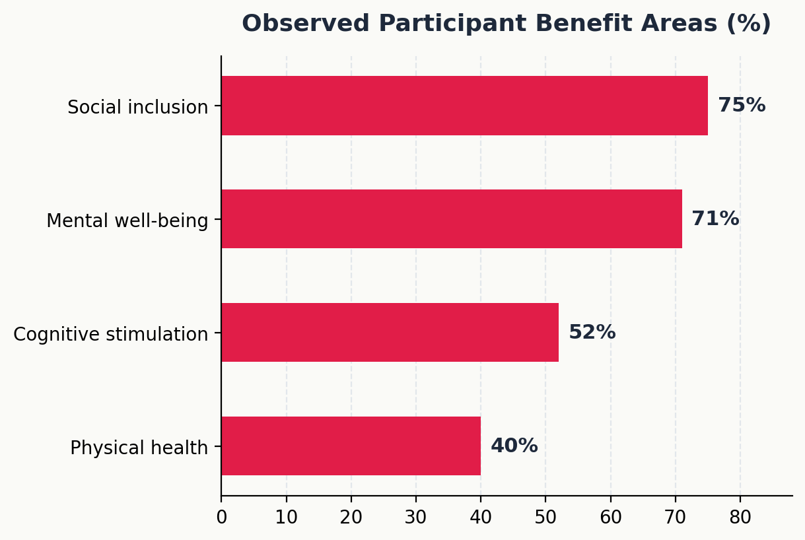
OBSERVED OUTCOMES
Quantitative impact: mental well-being and social connection
Adherence & retention
• 97.0% completion rate across structured cultural prescriptions.
• High retention driven by emotional safety and group bonding.
• Contrast with high drop-out rates in traditional psychotropic or clinical regimes.

Slide 14
FUNDING STRUCTURE
Financial sustainability
Public & philanthropic grants
30.2% Public grants & vouchers
• Philanthropic support (e.g. Compagnia di San Paolo)
• Regional pilot funding
Internal cultural budgets
28.4% Internal budget reallocation
• Museums and theaters absorbing costs from core operating funds
• High resource strain
Unfunded & out-of-pocket
28.1% Unfunded / Volunteer effort
19.3% Direct user fees
• High risk of inequality and burn-out
• Need for structural healthcare co-funding
multiple responses possible

Slide 15
HUMAN INFRASTRUCTURE
The link worker
The operational paradox
• 86.4% of entities state the Link Worker is essential for success.
• Only 24.1% possess a formally structured Link Worker role.
• 75.9% rely on informal, multi-tasking staff filling the gap without dedicated compensation.
Link worker qualifications
• 52.8% hold a Master's degree (Psychology, Sociology, Arts Management).
• 38.2% acquired expertise through field experience.
• Urgent need for formal national certification and recognized job profiles.

Slide 16
OPERATIONAL WORKFLOW
The prescription cycle: four key operational phases
Phase 1: Referral
Prescription by psychologist, social worker, or specialist physician.
Phase 2: Intake
Link worker intake, active listening, and co-design of cultural pathway.
Phase 3: Engagement
Participation in structured 8-12 week art, museum, or theater activities.
Phase 4: Follow-up
Outcome assessment (40% bottleneck: lacking formal follow-up).

Slide 17
QUALITATIVE INSIGHTS
Qualitative evidence: non-clinical spaces and dignity
De-sanitization of care environments
"Moving out of the clinic into a museum or library instantly changes the power dynamics. Participants stop feeling like patients under medical scrutiny."
— Expert Interview, Qualitative Panel
Preserving human dignity
• Beauty and aesthetics act as active therapeutic ingredients.
• Welcoming environments foster emotional openness.
• Reduces stigma associated with psychiatric or social care labels.

Slide 18
QUALITATIVE INSIGHTS
Qualitative evidence: identity transformation and agency
From passive patient to active creator
"In the choir or theater workshop, I am not my diagnosis. I am a voice, a performer, a co-creator."
— Focus Group Participant
Mechanisms of change
• Reactivation of personal agency and self-efficacy.
• Emotional self-regulation through artistic expression.
• Building lasting peer-to-peer social bonds beyond project duration.

Slide 19
OPERATIONAL BARRIERS
Qualitative synthesis: key barriers and critical bottlenecks
Sectoral silos
• Administrative division between health trusts and cultural departments.
• Lack of joint budgeting mechanisms.
GP awareness gap
• General Practitioners often unaware of local cultural assets.
• Need for accredited medical training modules.
Lack of standards
• Absence of unified impact evaluation frameworks.
• Informal status of link worker job descriptions.

Slide 20
CONCLUSIONS
Research conclusions
Summary of evidence
1. Extensive field: 918 entities form a rich, mature mosaic of practice — still largely uncoordinated.
2. Exceptional adherence: 97% completion rate proves participant engagement.
3. Psychologist-led model: Unique Italian model rooted in mental health care.
4. Urgent structural needs: Link worker funding and standardized evaluation.
Strategic recommendation
"Italian cultural welfare does not need to be invented from scratch; it needs to be institutionalized, funded, and recognized as a structural pillar of public health."
— Italian National Survey Report

Slide 21
BIBLIOGRAPHY
Bibliographical references and key sources
Core national reports
• CCW & Fondazione Compagnia di San Paolo (2025). Primo Rapporto Nazionale sulla Prescrizione Sociale in Italia.
• Italian Ministry of Culture – Ministry of Health (2025). Inter-institutional Protocol, Ministerial Decree No. 12, 21 January 2025.
• Tuscany Region (2026). Regional Resolution (DGR) No. 943, 27 July 2026 — first Italian regional guidelines on social prescribing.
International frameworks
• Fancourt D., Finn S. (2019). What is the evidence on the role of the arts in improving health and well-being? WHO Regional Office for Europe (HEN Synthesis Report 67).
• CultureForHealth (2023). Compendium of CultureForHealth project findings and policy recommendations. European Union.
• Dahlgren G., Whitehead M. (2021). The Main Determinants of Health. European Journal of Public Health.

Slide 22
Thank you for your attention
Simona Staffieri
Project Manager Officer
Cultural Welfare Center (CCW) • Italy
Website: www.culturalwelfare.center | Email: simona.staffieri@culturalwelfare.center
Culture, Health and Social Prescribing Conference • Ljubljana 2026

